Slide 1


Flight Delay Prediction
Introduction
By Rajat Roy | AP22110010673
Anyone who has ever booked a flight ticket knows how unexpectedly the flight timing varies. Airlines use using sophisticated tactics which they call "yield management".
According to a recent study, India is currently the 3rd largest civil aviation market in the world. According to IATA (International Air Transport Association) the number of flyers globally could double to 8.2 billion
in 2037.
Nowadays, in this ever advancing world time management has become a prominent factor in all business operations. We can’t afford to lose time on unnecessary delays. Using this as motivation we have developed a ML Model which predicts arrival flight delay based on various factors that include airport score, general airline trend, air traffic etc.

Slide 2
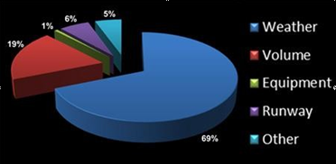
It is clearly visible from the pie chart that weather is one of the most prominent factors causing delay, hence we have extracted weather features separately.
The Busiest Airports are the ones where the probability of flight delay is high, hence we chose Bombay, Delhi, Bengaluru, Chennai, Hyderabad

Slide 3
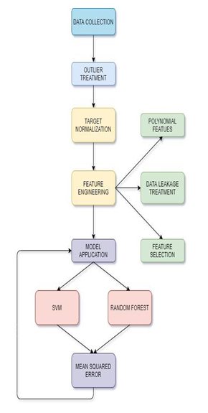
Techniques
Data collection and cleaning:
Collection of data from flightradar24.com by
web scraping using python package BeautifulSoup
which parsing HTML and XML documents.
Overall 23 features collected were collected from the website
Weather features were also extracted in a similar way using Beautiful Soup, 21 weather features were extracted
After categorical encoding, imputation of missing values and remove of rows with many null values, final dataset obtained had 10313 rows and 44 columns.

Slide 4
Data pre-processing and model application
Removal of the Departure Delay feature it caused Data Leakage
Outlier Removal: We considered only delays from 3 hrs early to 3 hrs late.
Normalized the target variable so that our model
generalises well in real life.
Finally inverse transform was applied to target variable to show predicted delays.
Applied Interaction features which allowed us to capture better insights about the data.
Careful feature selection based on their importance. This allowed the model to improve its performance as well as reduce training time.
Started with basic linear models but they performed poorly, hence shifted to tree based ensemble models, they performed much better than better prediction were obtained.
The evaluation metric used was
Mean Squared Error,

Slide 5
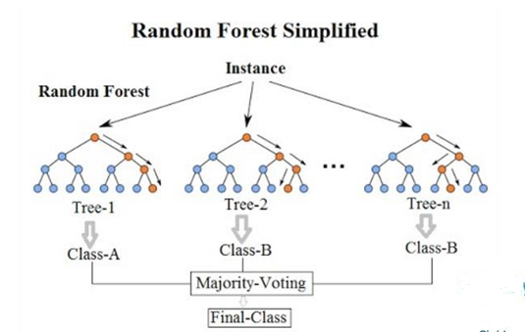
What is Random Forest?
Random Forest is an ensemble algorithm, which randomly creates a set of decision trees, which then aggregates the votes from all decision trees to decide the final class of the test object.

Slide 6
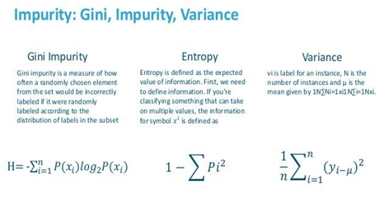
What is Impurity in Random Forest ?
The impurity of a node is the probability that a randomly chosen sample in a node would be incorrectly labeled if it was labeled by the distribution of samples in the node.
\

Slide 7
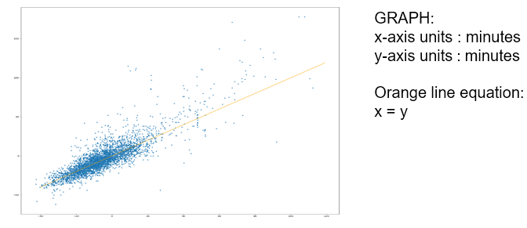
Results
After careful hyperparameter tuning by Randomized Search Cross Validation and application of various ML models
The training mean square error is obtained to be 0.13 and the test set
mean square error is obtained to be 0.25.
\

Slide 8
Conclusion
Go Air was found to be the airline with least delay with an average delay of 11 minutes.
SpiceJet was found to be the airline with most delay with an average delay of 18 minutes.
The Airport which had the most Delay was Bangalore, and the airport with the least delay was Hyderabad.
Of of the given 44 parameters, Wind Gust, Cloud Cover and Airport Location
were the most important which affected the delay the most.
As expected the Delay is high on Public Holidays and major religious festivals.
\

